Slide 1

Data Mining
Computer Science & Engineering, Khulna University
Mining Frequent Patterns, Association, and Correlations
Dr. Amit Kumar Mondal,
Associate Professor, CSE KU

Slide 2
Frequent Pattern Mining
Frequent patterns are patterns (e.g., itemsets, subsequences, or substructures) that appear frequently in a data set.
a set of items, such as milk and bread, that appear frequently together in a transaction data set is a frequent itemset
It searches for recurring relationships in a given data set
Usage – for the discovery of interesting associations and correlations between itemsets in transactional and relational databases.

Slide 3
Market Basket Analysis
Transac id | Customer | Purchased Items
1 |  | Milk, bread, cereal
2 |  | Milk, bread, sugar, eggs
3 |  | Milk, bread, butter
4 |  | sugar, eggs
5 |  | Milk, eggs, cereal

Slide 4
Market basket analysis
Frequent itemset mining leads to the discovery of associations and correlations among items in large transactional or relational data sets.
The discovery of interesting correlation relationships can help in many business—
catalog design, cross-marketing, and customer shopping behavior analysis , o plan marketing or advertising strategies,
market basket analysis. -- analyzes customer buying habits by finding associations between the different items that customers place in their “shopping baskets”.
The discovery of these associations can help retailers develop marketing strategies by gaining insight into which items are frequently purchased together by customers.
For instance, if customers are buying milk,
---how likely are they to also buy bread on the same trip in the supermarket

Slide 5
Association Rules
association rule
Support
Confidence
Strong Rule

Slide 6
Frequent Itemsets, Closed Itemsets
A set of items is referred to as an itemset. An itemset that contains k items is a k-itemset.
frequent itemset.
For example, a frequent itemset of length100, such as {a1, a2,….a100}

Slide 7
Frequent Itemsets, Closed Itemsets
This is too huge a number of itemsets for any computer to compute or store.
To overcome this difficulty, practitioners introduce the concepts of closed frequent itemset and maximal frequent itemset.
An itemset X is closed in a data set D if there exists no proper super-itemset Y such that Y has the same support count as X in D.
An itemset X is a closed frequent itemset in set D if X is both closed and frequent in D.
An itemset X is a maximal frequent itemset (or max-itemset) in a data set D if X is frequent, and there exists no super-itemset Y such that X ⊂ Y and Y is frequent in D.

Slide 8
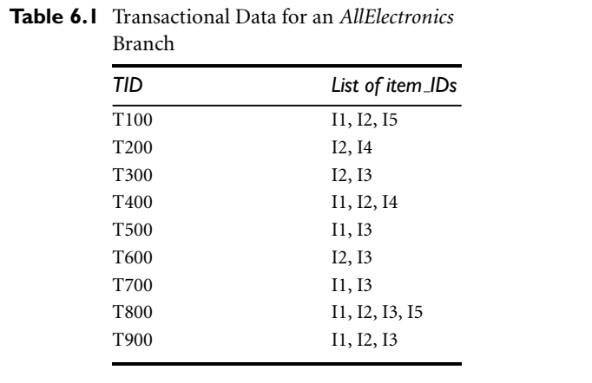
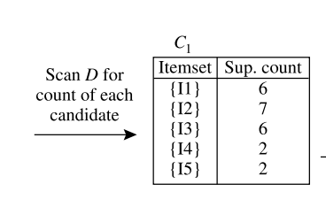
Apriori Algorithm: Example

Slide 9
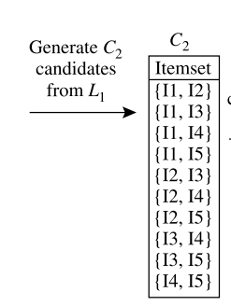
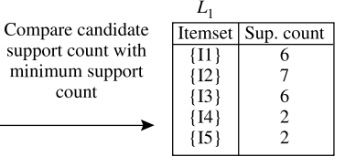
Apriori Algorithm: Example

Slide 10
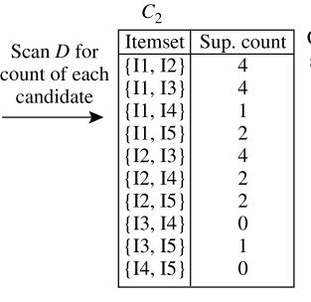
Apriori Algorithm: Example

Slide 11
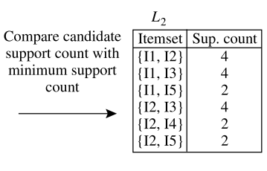
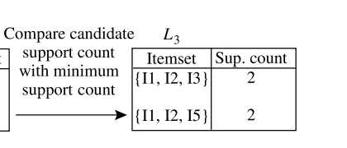
Apriori Algorithm: Example

